Slide 1

Principles of communications
Chapter2 Random processes—Part III

Slide 2
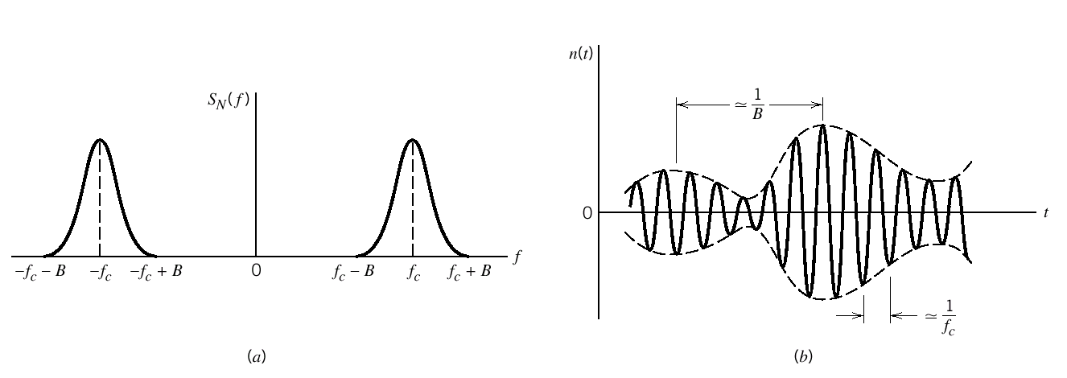
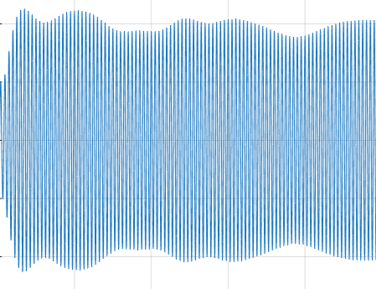
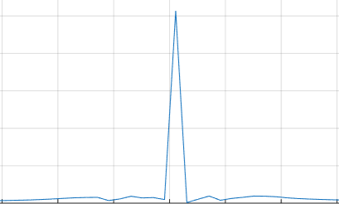
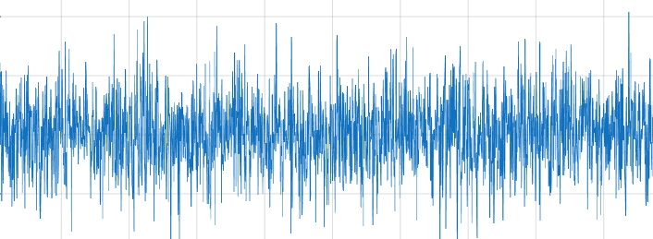
Chapter 2：Random Processes——Part III
Narrowband Random Process 窄带随机过程 窄带噪声
Sine Wave Plus Narrowband Noise 信号+噪声
Gaussian white noise and band pass white noise
Or 各路信号反射信号干涉
通信系统中不同阶段的噪声

Slide 3
Chapter 2：Random Processes——Part III
Narrowband Random Process 窄带随机过程
--Definition
--In-phase and quadrature component form 同相分量正交分量
--Envelope-phase form包络相位
--Narrowband Stationary Gaussian窄带平稳高斯
Sine Wave Plus Narrowband Noise
--Rician distribution莱斯分布 (广义Rayleigh distribution).
--Rayleigh distribution 瑞利分布
Gaussian white noise and band pass white noise
--White noise 白噪声
-- Low-pass Gaussian noise 低通型
-- Band-pass Gaussian noise 带通型

Slide 4
Chapter 2：Random Processes——Part III
Narrowband Random Process 窄带随机过程
--Definition
--In-phase and quadrature component form
--Envelope-phase form
--Narrowband Stationary Gaussian窄带平稳高斯
Two formulas

Slide 5
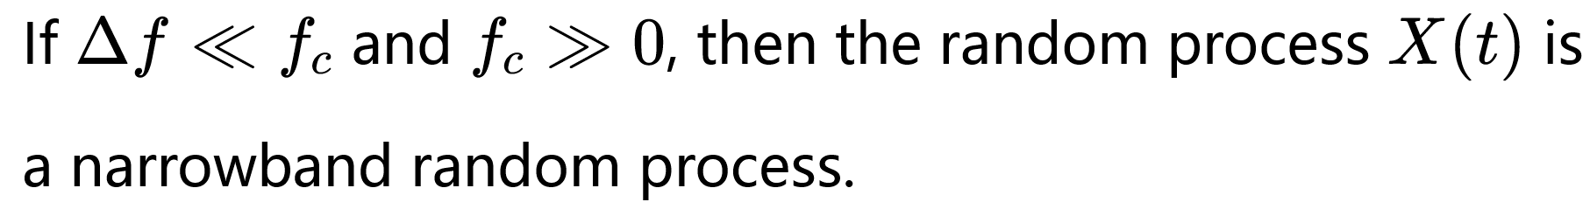
Chapter 2：Random Processes——Part III
Narrowband Random Process 窄带随机过程-definition
Frequency domain
Time domain
随机缓慢变化

Slide 6
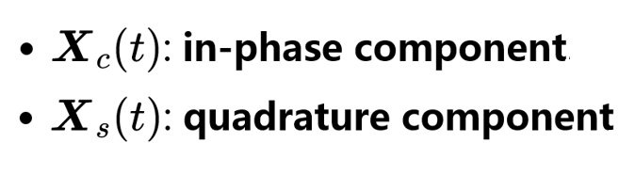
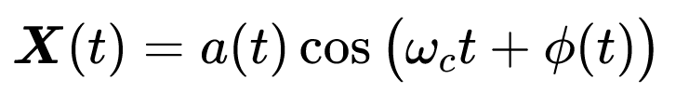
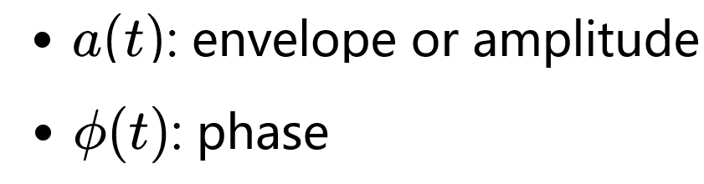
Chapter 2：Random Processes——Part III
Narrowband Random Process 两种表达式
--In-phase and quadrature (I/Q) component form
--Envelope-phase form
同相分量
正交分量

Slide 7

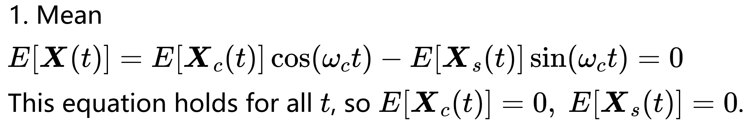
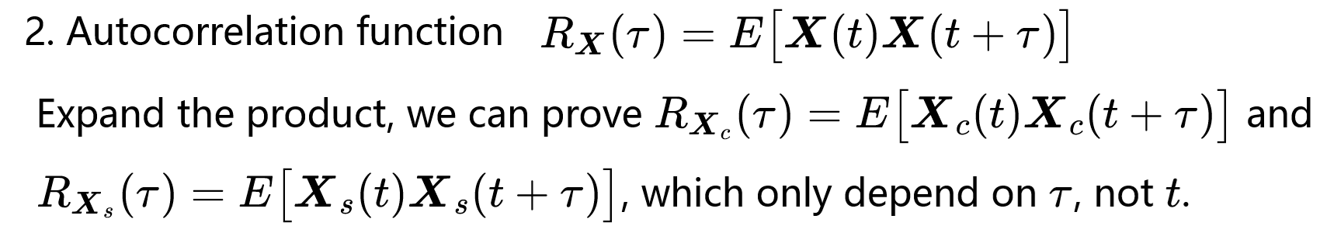
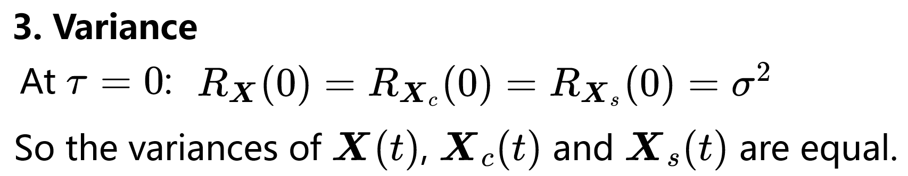
Narrowband Random Process

Slide 8
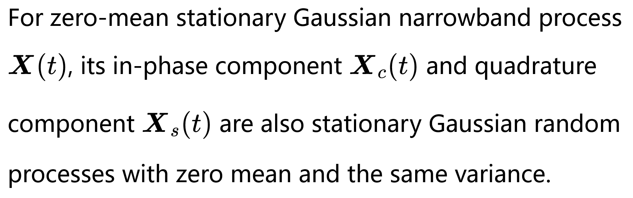
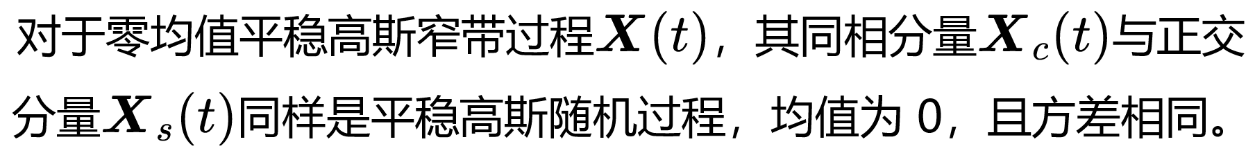
Narrowband Random Process
Conclusion

Slide 9
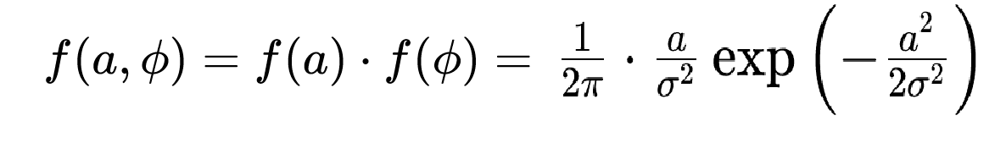
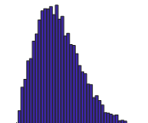
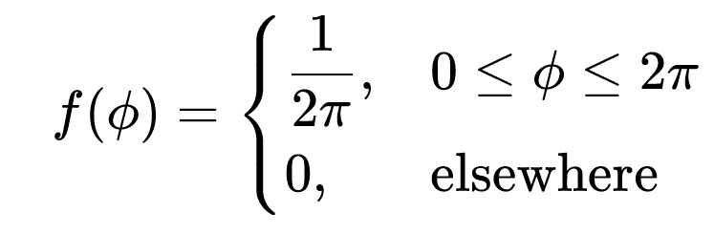
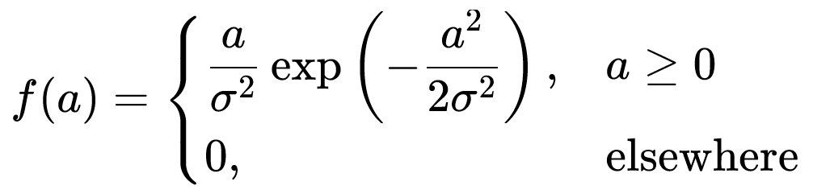
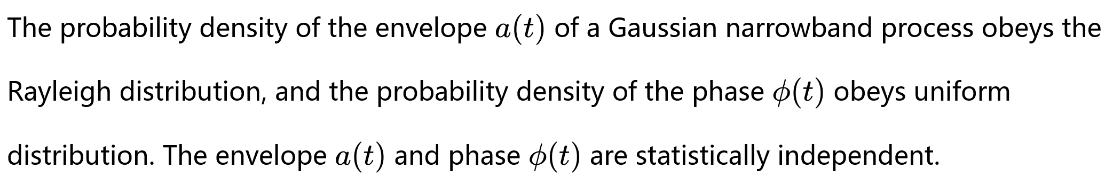
统计独立 independent
Rayleigh distribution
uniform distribution

Slide 10
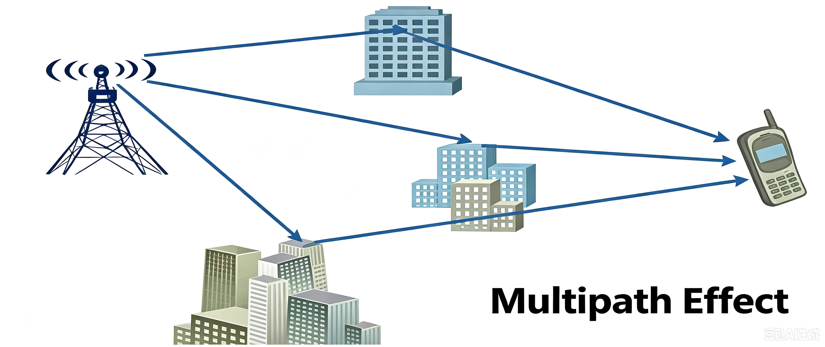
Rayleigh distribution（场景）
各路信号反射信号干涉
There are N independent multipath channels without dominant line-of-sight component. Only reflected waves exist, and the envelope of the received signal follows Rayleigh distribution.
有N个多径信道，它们彼此相互独立且没有一个信道的信号占支配地位；没有直射波信号，仅有许多反射波信号，接收到的信号包络的衰落变化服从瑞利分布

Slide 11
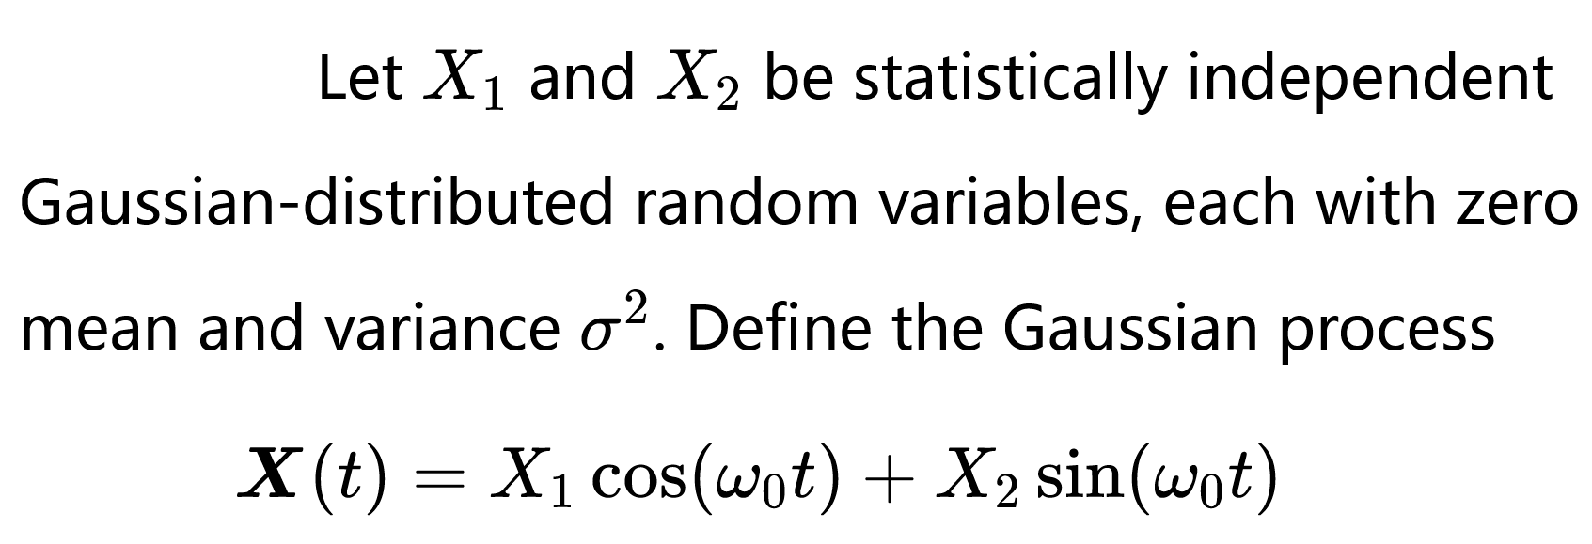
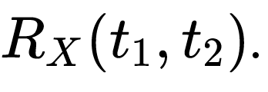
Example 2

Slide 12
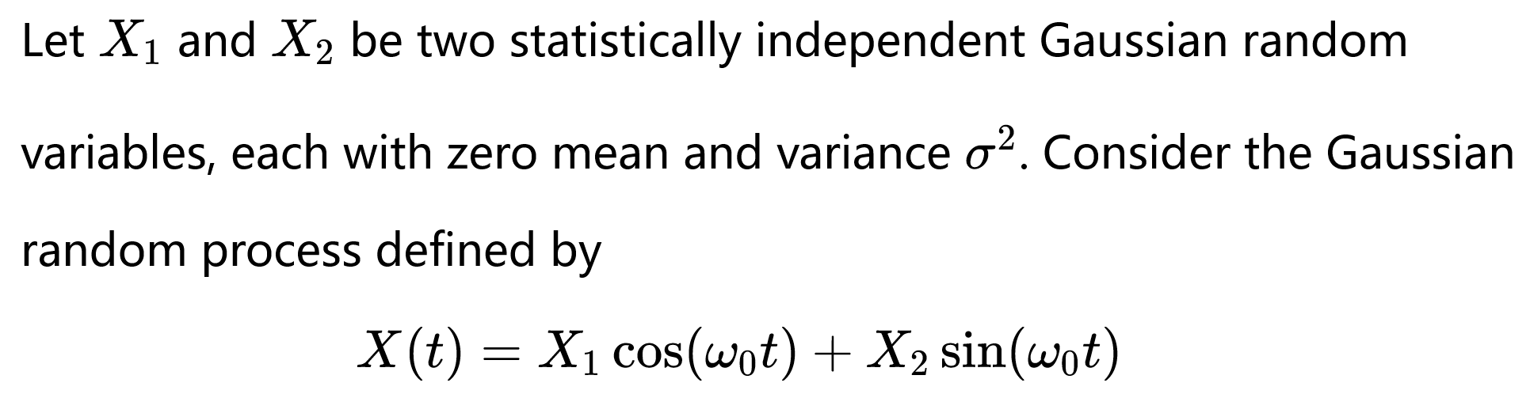
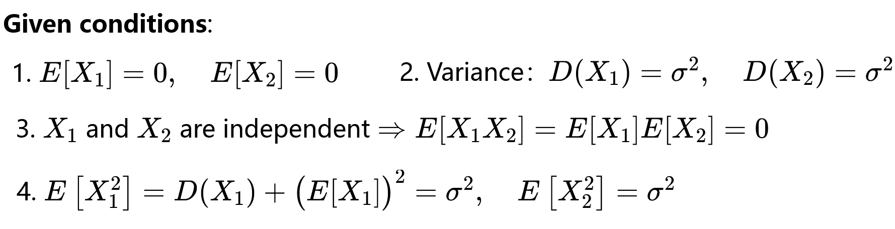
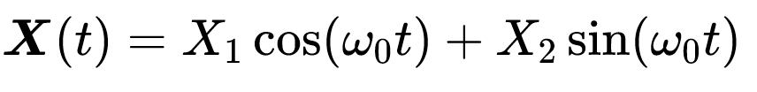
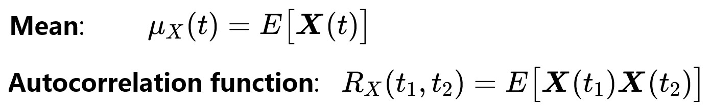

Slide 13
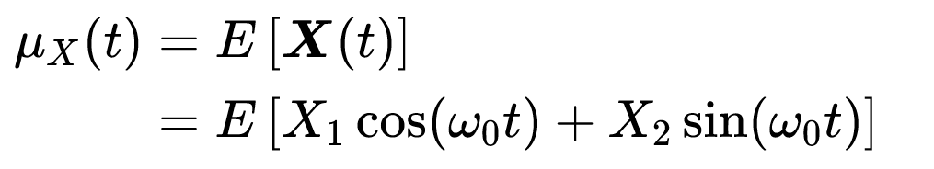

Slide 14
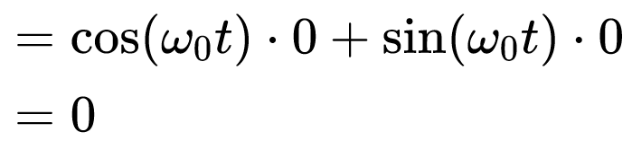

Slide 15
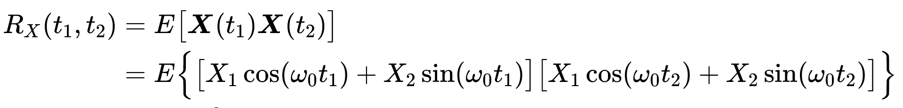
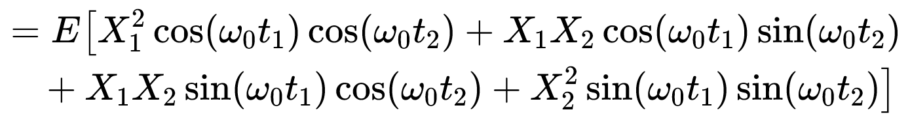

Slide 16
Example 2
Conclusion: For a fixed instant of time t, linear combinations of stationary Gaussian random processes are also stationary Gaussian random processes with the same distribution.

Slide 17
Chapter 2：Random Processes——Part III
Narrowband Random Process 窄带随机过程
--Definition
--In-phase and quadrature component form
--Envelope-phase form
--Narrowband Stationary Gaussian窄带平稳高斯
Two formulas

Slide 19
Chapter 2：Random Processes——Part III
Narrowband Random Process 窄带随机过程
--Definition
--In-phase and quadrature component form 同相分量正交分量
--Envelope-phase form包络相位
--Narrowband Stationary Gaussian窄带平稳高斯
Sine Wave Plus Narrowband Noise
--Rician distribution莱斯分布 (广义Rayleigh distribution).
--Rayleigh distribution 瑞利分布
Gaussian white noise and band pass white noise
--White noise
-- Low-pass noise 低通型
-- Band-pass noise 带通型

Slide 20
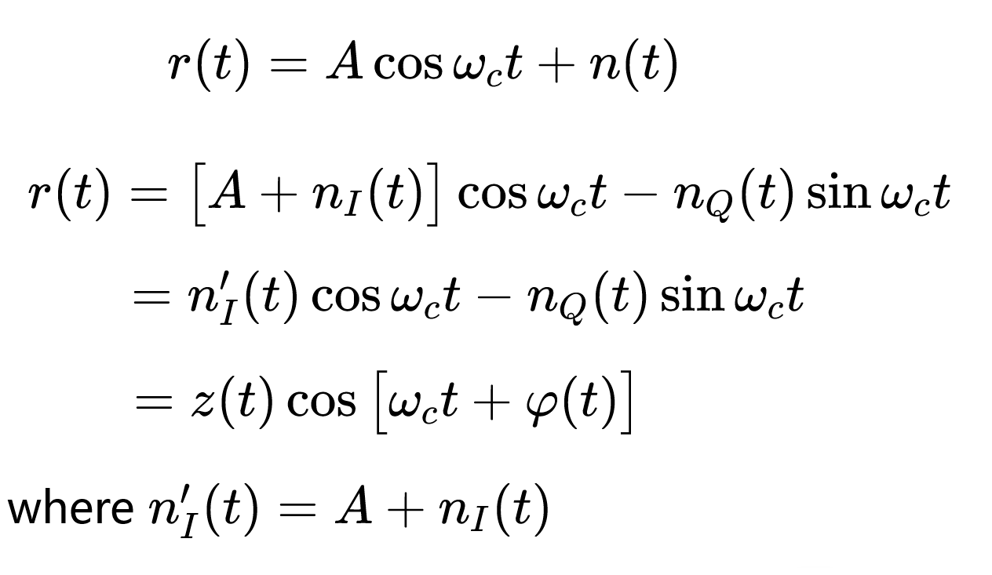
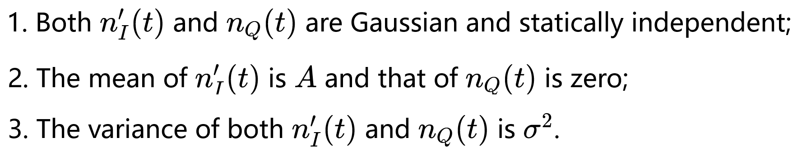
Chapter 2：Random Processes——Part III
Sine Wave Plus Narrowband Noise
正弦波加载窄带高斯噪声
$$prime$$
Properties:

Slide 21
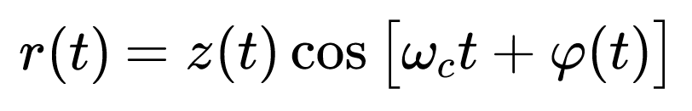
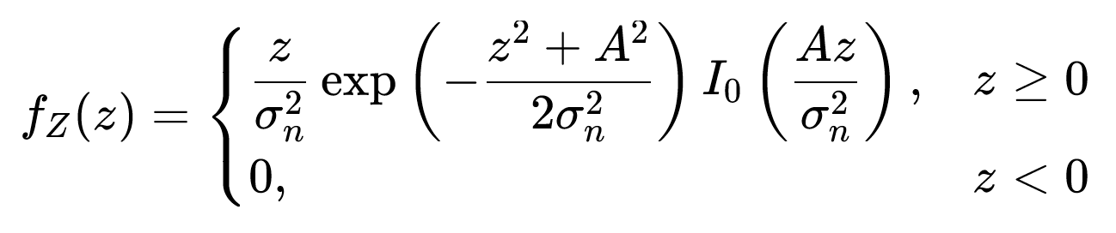
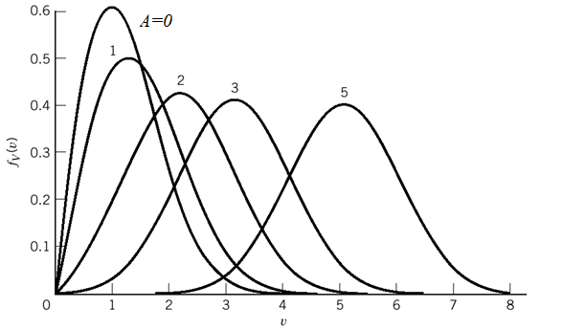

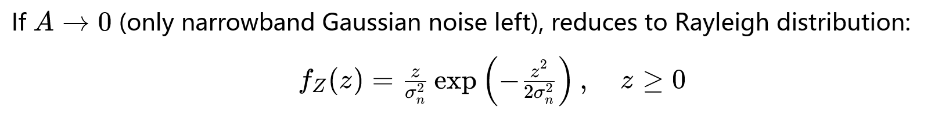
Chapter 2：Random Processes——Part III
Sine Wave Plus Narrowband Noise
正弦波加载窄带高斯噪声
莱斯分布
Where is zero-order modified Bessel function of the first kind.
零阶修正贝塞尔函数
强信号时，
接近高斯分布
只有窄带高斯噪声时
退化为瑞利分布

Slide 22
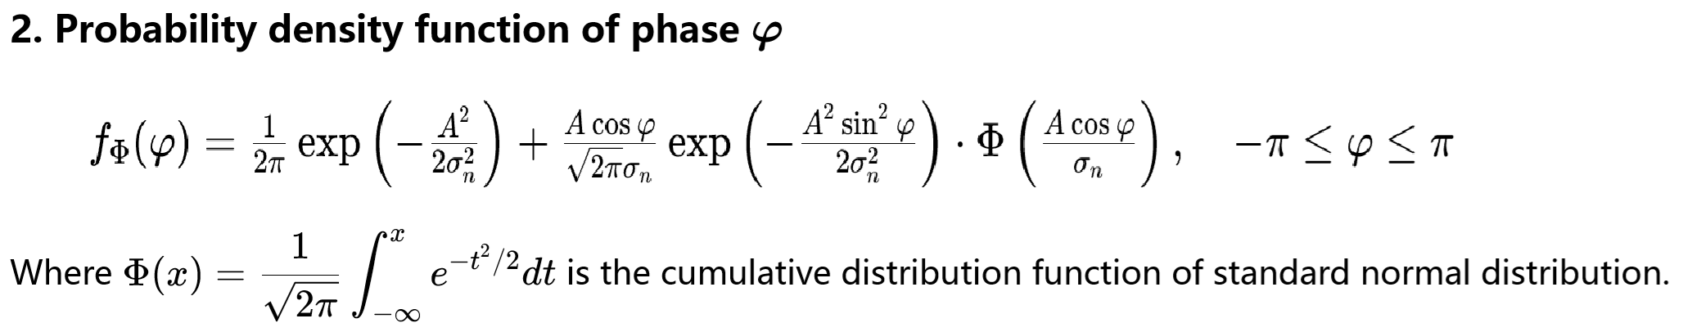
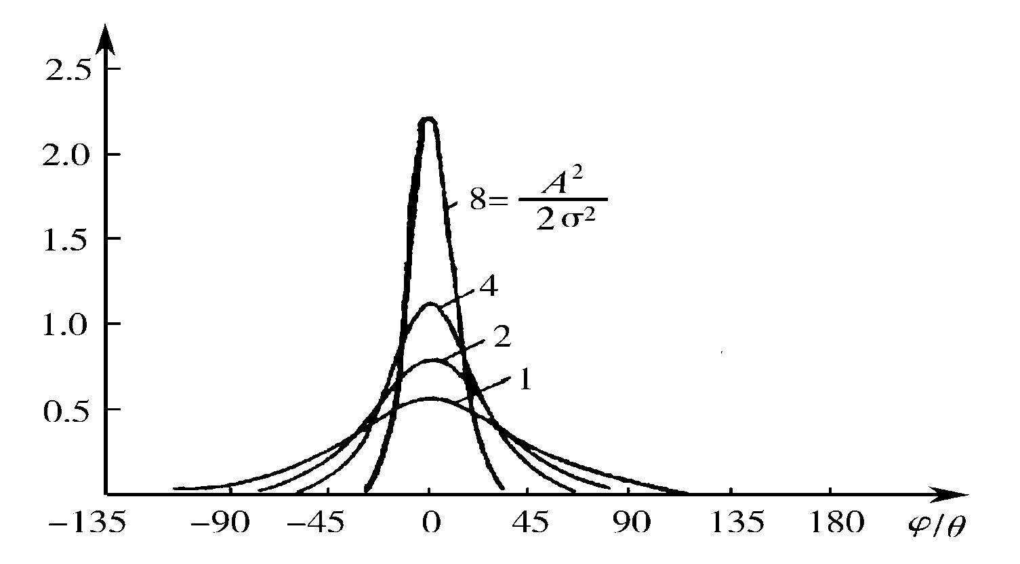
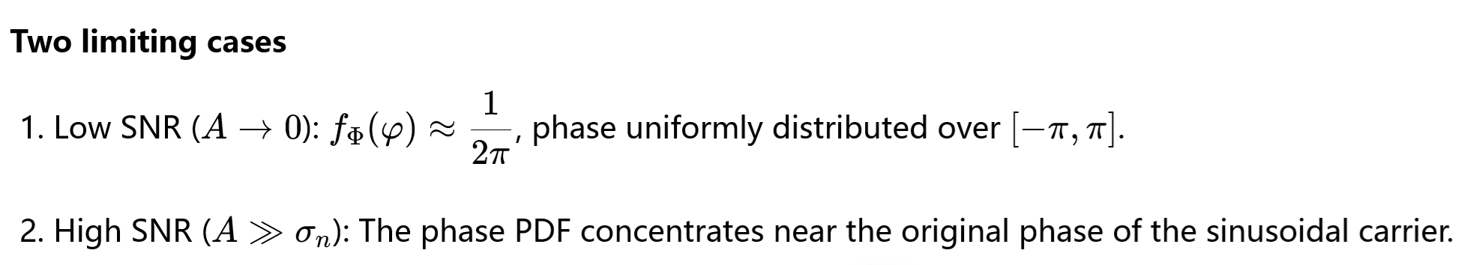
Chapter 2：Random Processes——Part III
Sine Wave Plus Narrowband Noise
正弦波加载窄带高斯噪声
集中在有用信号附近
f(ϕ)

Slide 23
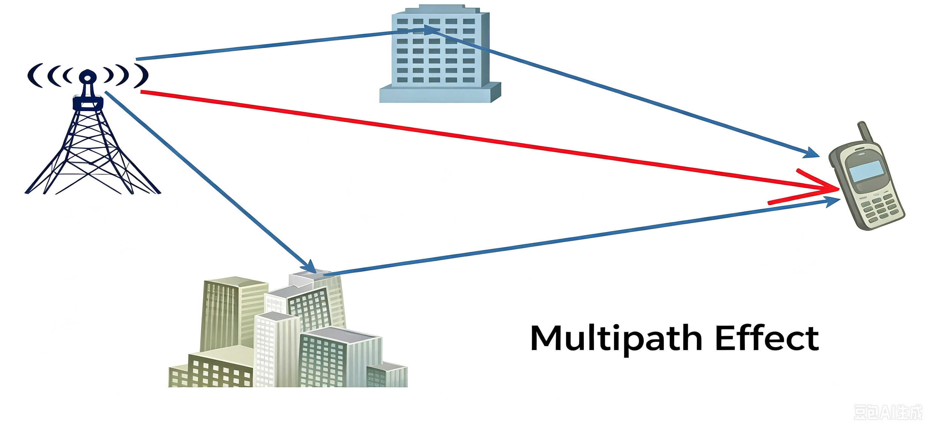
Chapter 2：Random Processes——Part III
Multi-path propagation（多径传播）
Rayleigh distribution 瑞利分布
Rician distribution 莱斯分布
In a multipath channel:
① There are N independent multipath components. None of them dominates. There is no direct wave, only many reflected waves. The envelope of the received signal follows Rayleigh distribution.
有N个多径信道，它们彼此相互独立且没有一个信道的信号占支配地位；没有直射波信号，仅有许多反射波信号，接收到的信号包络的衰落变化服从瑞利分布。

Slide 24
Chapter 2：Random Processes——Part III
Multi-path propagation（多径传播）
Rayleigh distribution 瑞利分布
Rician distribution 莱斯分布
In a multipath channel:
②If a strong direct wave exists and dominates the received signal, the envelope of the received signal follows Rician distribution
当接收到较强的直射波信号且它占有支配地位时，接收信号包络的衰落变化服从莱斯(Rician)分布。

Slide 25
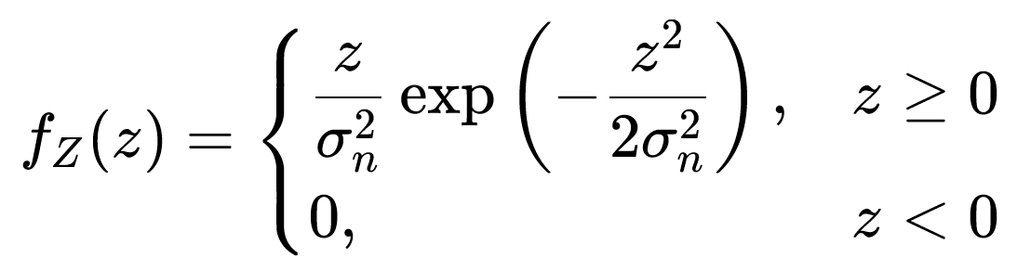
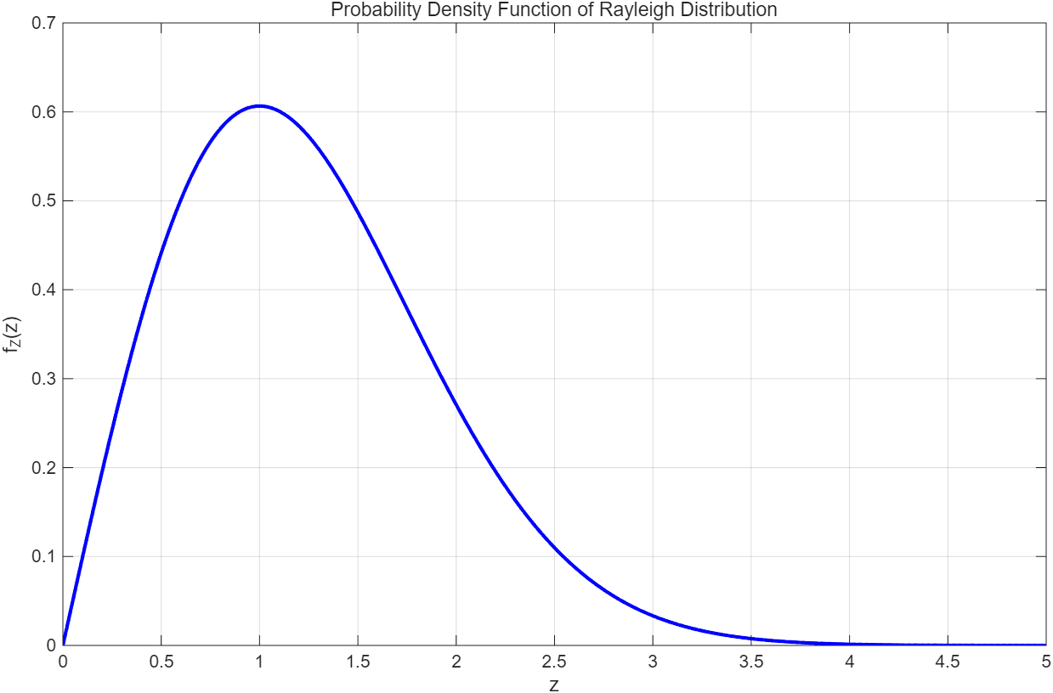
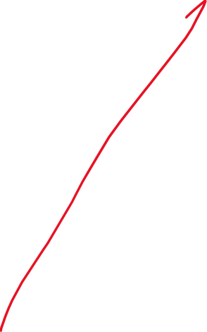
Rician distribution 莱斯分布
Rayleigh distribution 瑞利分布

Slide 26
True / False
( ) Rician distribution can be regarded as a generalized Rayleigh distribution.
( ) When there is no direct wave and only reflected waves, the envelope of received signal follows Rician distribution.
( ) A narrowband random process can be expressed by in-phase and quadrature components.

Slide 27
True / False
4. ( ) Gaussian noise includes low-pass Gaussian noise and band-pass Gaussian noise.
5.( ) Rayleigh distribution occurs when there exists a strong direct wave.
6. ( ) Envelope-phase form is one representation of narrowband random process.

Slide 29


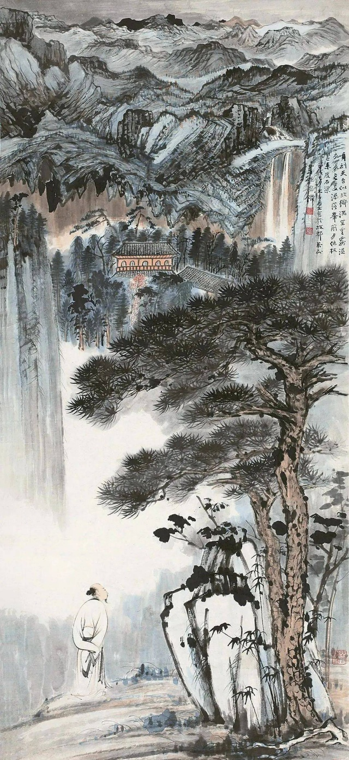
张大千山水画

Slide 30
Chapter 2：Random Processes——Part III
Narrowband Random Process 窄带随机过程
--Definition
--In-phase and quadrature component form 同相分量正交分量
--Envelope-phase form包络相位
--Narrowband Stationary Gaussian窄带平稳高斯
Sine Wave Plus Narrowband Noise
--Rician distribution莱斯分布 (广义Rayleigh distribution).
--Rayleigh distribution 瑞利分布
Gaussian white noise and band pass white noise
--White noise
-- Low-pass Gaussian noise 低通型
-- Band-pass Gaussian noise 带通型

Slide 31
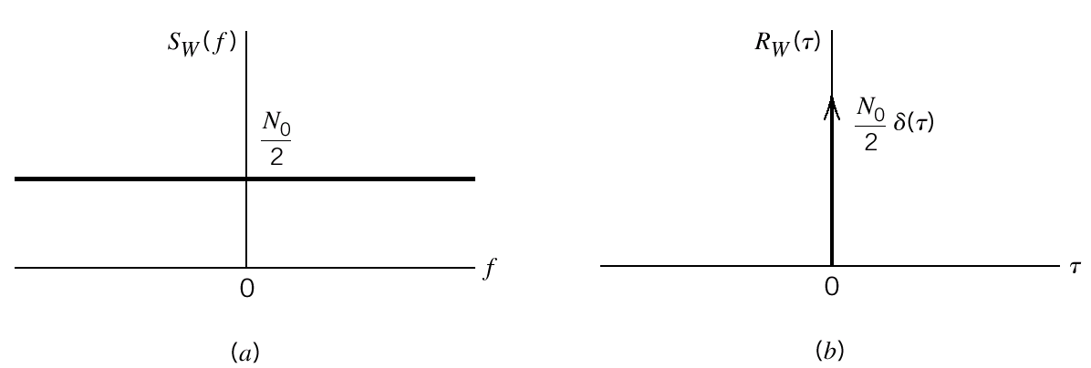

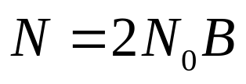
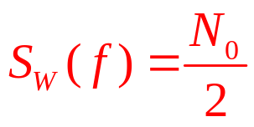
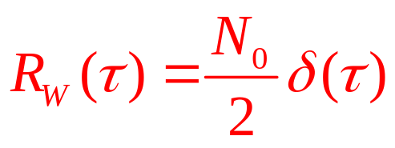
Gaussian white noise 高斯白噪声
An idealized form of noise for noise analysis of communication systems.
white：all frequency
Boltzmann’s constant
Equivalent noise temperature
Figure Characteristics of white noise.
(a) Power spectral density. (b) Autocorrelation function.

Slide 32
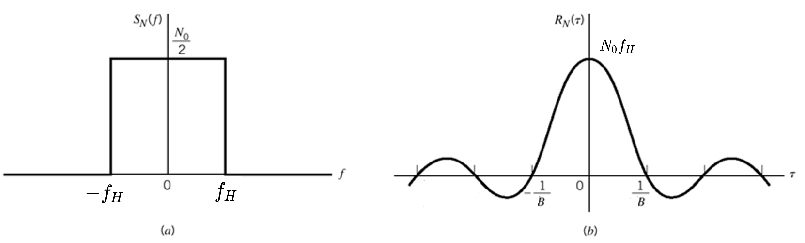
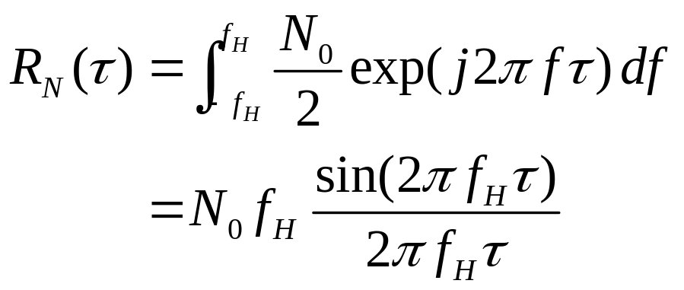
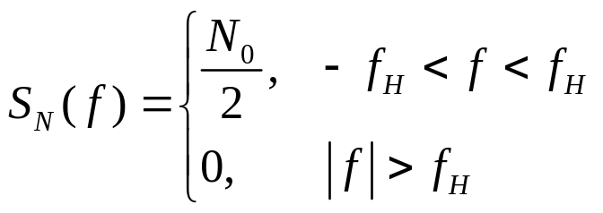
Low pass noise 低通型
傅里叶变换及欧拉公式
Figure Characteristics of low-pass filtered noise.
(a) Power spectral density. (b) Autocorrelation function.

Slide 33




Low pass noise 低通型

Slide 34




Band pass noise:带通型
Average Power: $N_{0}B$

Slide 35



Gaussian noise
Gaussian distribution | PSD | R(τ）
AGWN 加性高斯白噪声
低通型：LP
带通型：BP

Slide 36



Gaussian noise
Gaussian distribution | PSD | R(τ）
AGWN 加性高斯白噪声
低通型：LP
带通型：BP

Slide 37


Slide 38

Understanding noise distribution at different receiver stages is critical for noise power calculation.
掌握接收机不同阶段的噪声分布，对噪声功率计算十分关键。
Thinking Question:
Analyze this framework and derive input/output signals, noise variations and noise power changes.
认真分析这个框架，推导输入输出信号、噪声的变化，不同阶段噪声功率的变化。

Slide 39
Understanding noise distribution at different receiver stages is critical for noise power calculation.
掌握接收机不同阶段的噪声分布，对噪声功率计算十分关键。
Thinking Question:
Analyze this framework and derive input/output signals, noise variations and noise power changes.
认真分析这个框架，推导输入输出信号、噪声的变化，不同阶段噪声功率的变化。

Slide 40
猜一猜
Guess!
-- White noise
-- Low-pass gaussian noise
-- Band-pass gaussian noise
Understanding noise distribution at different receiver stages is critical for noise power calculation.
掌握接收机不同阶段的噪声分布，对噪声功率计算十分关键。

Slide 41
Gaussian noise
-- White noise
-- Low-pass gaussian noise
-- Band-pass gaussian noise
All three cases are Gaussian random processes.
Reason: A Gaussian random process passing through a linear system (BPF or LPF) remains Gaussian.
Filtering only modifies PSD and autocorrelation function, without changing the Gaussian property.

Slide 42






猜一猜
噪声功率的计算
--White noise

Slide 43



猜一猜
噪声功率的计算
-- Band-pass gaussian noise

Slide 44


猜一猜
噪声功率的计算
BPF
B depends on signal
The BPF limits the noise bandwidth, turning infinite-power ideal white noise into finite-power band-pass noise for demodulation.

Slide 45

猜一猜
LPF后噪声功率的计算：思考
-- Low pass gaussian noise
？
LPF

Slide 46




调制解调的框架及数学推导
全书最核心的数学推导
BPF
哪个模块+LPF可以恢复出m(t)？

Slide 48


Example
1
0

Slide 49



1
(1) Autocorrelation function

Slide 50

Mind map

Slide 51


